Slide 1
VMware NSX 6.1
What’s New

Slide 2
Topics
Overview
Equal Cost Multipath
DHCP Relay
L2VPN Enhancements
Distributed Firewall Enhancements
Load Balancing and ADCaaS Enhancements
Platform Enhancements
vCloud Automation Center 6.1 Integration
Resources

Slide 3
Overview

Slide 4

What’s New: Data Plane
Consumption
Operations
Services
Data Plane
NSX Edge
Active-Active with Scale-Out (ECMP)

Slide 5





What’s New: Services
Consumption
Distributed Firewall Improvements
DDI DHCP Relay
Multi-Site & Hybrid Cloud Enablement
Layer 2 VPN , Active-Active DC, SRM Validation
Operations
Services
Firewall Ecosystem Enablement
Data Plane
LBaaS
UDP support, ecosystem enablement

Slide 6




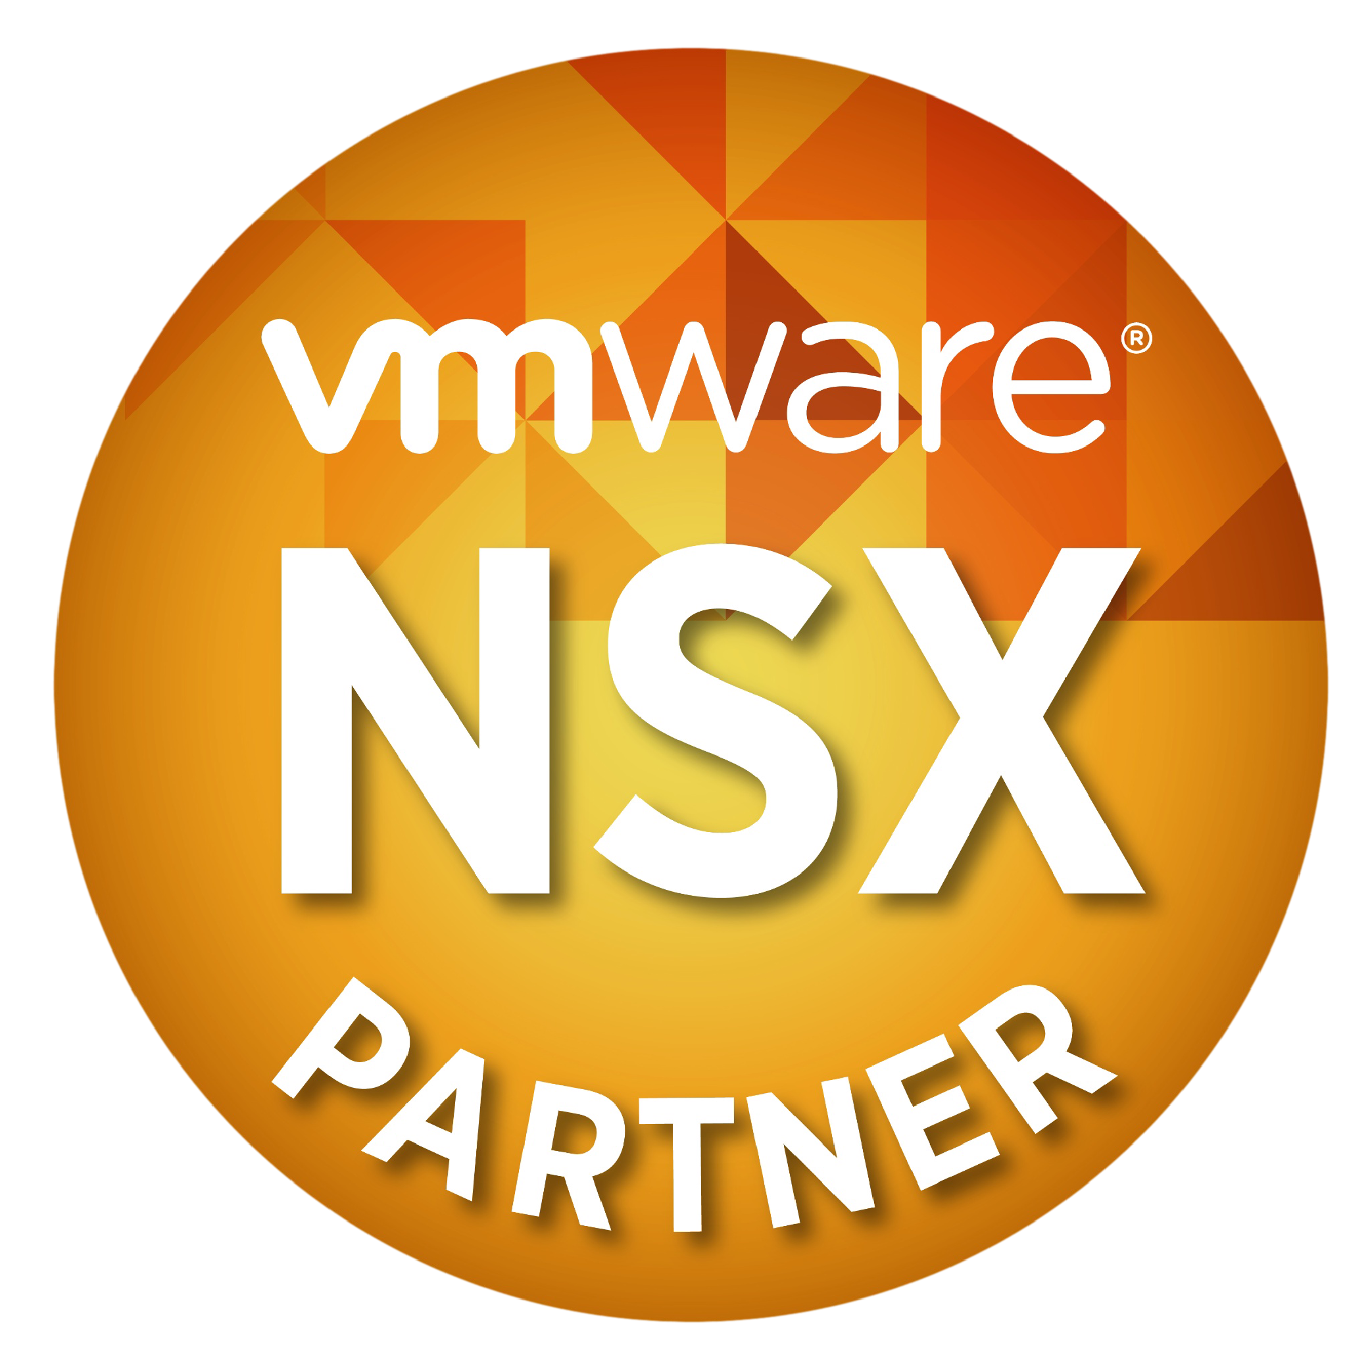
What’s New: Operations
Consumption
Firewall Operations
Tufin, Algosec
Operations Guides & Best Practices
Integration with Existing Tools
Riverbed, Gigamon, NetScout, EMC Smarts
Operations
Analytics
VMware vCenter Ops, Log Insight
Services
New NSX Partners & Service Categories
Physical-to-Virtual Services
Operations & Visibility
Application Delivery Services
Security Services
Data Plane

Slide 7


What’s New: Consumption
Consumption
vCloud Automation Center
More topologies and on demand use cases
Operations
Services
Data Plane

Slide 8
Equal Cost Multipath (ECMP)

Slide 9
Equal Cost Multipath
New in 6.1
Active/Active HA model with up to eight (8) NSX Edges
Increased bandwidth for North-to-South communication
Speed up recovery in an NSX Edge failure scenario
ECMP is disabled on the Distributed Logical Router, by default
ECMP on the Distributed Logical Router is new to 6.1 SW NSX Releases

Slide 10
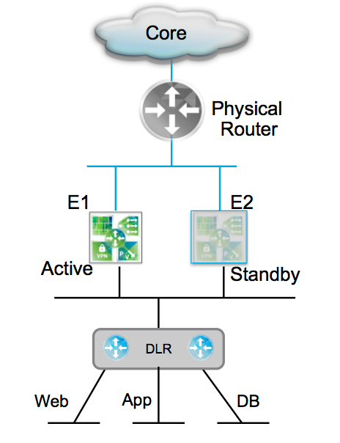
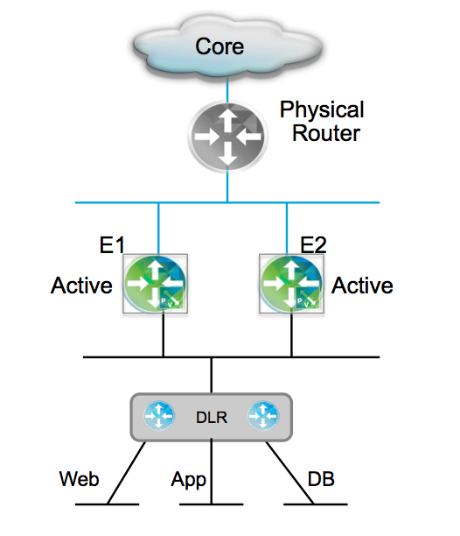
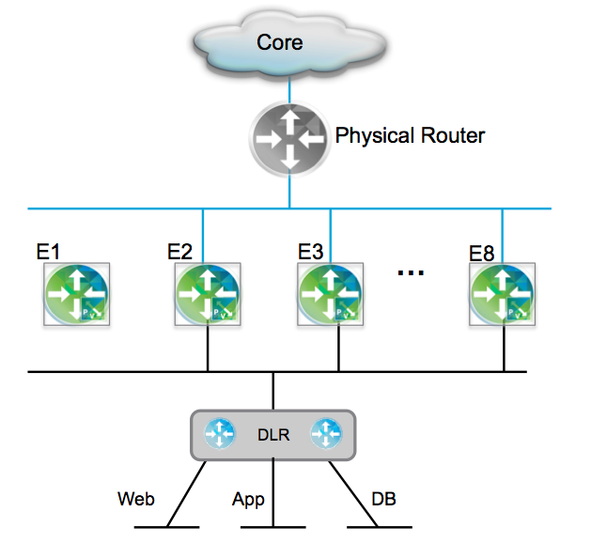

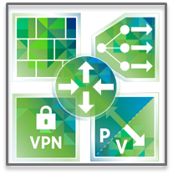




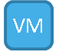


Logical Routing High Availability
Active/Standby HA Model
Standalone HA Model
ECMP HA Model
External Network
NSX Edge
Active/Standby HA Model
DLR Control VM
Distributed Routing
Active
Standby
Web1
App1
DB1
Notes:
Active/Standby is the traditional model
Standalone is two-active model
ECMP HA is the many active model
(Standalone HA and ECMP HA are both ECMP enabled models)

Slide 11





Standalone HA Model: 2 NSX Edges (1)
North-to-South traffic is handled by one of two active NSX Edges
Recommendations
Aggressively tune the hello/holdtime routing timers (1/3 seconds)
No need for deploying standby unit for any active NSX Edge
vSphere HA should be enabled for the NSX Edge virtual machines
Stateless behavior in Active/Active model
No support for stateful FW, LB, NAT across the active NSX Edges
VXLAN
Core
VLAN
Physical Router
Routing
Adjacency
E1
E2
Active
Routing
Adjacency
DLR
Web
App
DB

Slide 12
Standalone HA Model: 2 NSX Edges (2)
On failure of NSX Edge E1:
The DLR times-out the routing adjacency with the failed Edge
Routing tables are updated to reference the second active unit
VXLAN
Core
VLAN
Physical Router
Routing
Adjacency
E1
E2
X
Failed
Active
Routing
Adjacency
DLR
Web
App
DB

Slide 13
ECMP HA Model: Up to 8 NSX Edges (1)
Up to eight NSX Edges supported
North-to-South traffic is handled by all active NSX Edges
ECMP can be enabled and configured on both the DLR and NSX Edge
Traffic is hashed across paths based on the Src/Dst IP address values
When ECMP is enabled, the NSX Edge firewall is disabled
Stateless behavior in Active/Active model
No support for stateful FW, LB, NAT across the active NSX Edges
VXLAN
Core
VLAN
Physical Router
Routing
Adjacencies
E1
E2
E3
…
E8
DLR
Web
App
DB

Slide 14
ECMP HA Model: Up to 8 NSX Edges (2)
On failure of an NSX Edge:
The DLR and physical router time out the routing adjacencies
Routing table entries are removed
Corresponding flows are re-hashed thru the remaining active units
VXLAN
Core
VLAN
Physical Router
Routing
Adjacencies
E1
X
E2
E3
…
E8
DLR
Web
App
DB

Slide 15
ECMP HA Model: Up to 8 NSX Edges (3)
Recommendations
Aggressively tune the hello/holdtime routing timers (1/3 seconds)
No need for deploying standby unit for each active NSX Edge
vSphere HA should be enabled for the NSX Edge virtual machines
VXLAN
Core
VLAN
Physical Router
Routing
Adjacencies
E1
X
E2
E3
…
E8
DLR
Web
App
DB

Slide 16
DHCP Relay

Slide 17
DHCP (1)
New in 6.1
DHCP relay configuration can be applied on the DLR and the NSX Edge
Supports multiple relay agents along the same data-path
Many DHCP servers can be configured to receive relayed messages

Slide 18


DHCP (2)
Relay DHCP messages from virtual machines in the NSX domain to existing external DHCP servers
Leverage existing DHCP infrastructure
DHCP server X
DHCP server Y
Server X
Server Y
Distributed router
Server X
Logical SW
Logical SW
VM

Slide 19
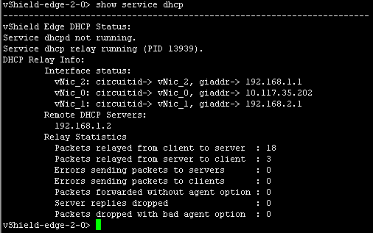
CLI (1)
CLI: show service dhcp
Enhanced output in 6.1

Slide 20
CLI (2)
vShield Edge DHCP Config:
{
"dhcp" : {
"relay" : {
"maxHopCounts" : 10,
"servers" : [
"192.168.1.2"
],
"agents" : [
{
"interface" : "vNic_1",
"giaddr" : [
"192.168.2.1"
]
}
]
},
"logging" : {
"enable" : true,
"logLevel" : "debug"
},
"enable" : true,
"bindings" : {},
"leaseRotateTime" : 900,
"leaseRotateThreshold" : 10000
}
}
CLI: show config dhcp
Enhanced output in 6.1

Slide 21
L2VPN Enhancements

Slide 22
NSX Multi-Site L2VPN Enhancements
VXLAN and VLAN trunk support
Multiple internal networks can be extended per edge
Edge can handle more than 10 networks by allowing multiple networks to be trunked on a single interface
L2 VPN Client Appliance unbundled from NSX management
Solution will work without NSX or vCenter Server on the client-side
Egress Optimization is supported
L2 ARP filtering of remote gateway
Ability to route over tunnel to remote networks that aren’t stretched at L2
Operational improvements: Support for HA and expanded CLI command set
Extended platform support
Can be used with earlier vSphere versions and ESXi-only environments
Notes:
VXLAN and VLAN trunk support:
New 6.1
L2 VPN Client Appliance unbundled from NSX management:
New 6.1
Egress Optimization is supported
Enhanced in 6.1
Ability to route over tunnel to remote networks that aren’t stretched at L2
New 6.1
Operational improvements: Support for HA and expanded CLI command set
Enhanced in 6.1
Extended platform support
New in 6.1

Slide 23



NSX Multi-Site L2VPN
Enterprise
Hybrid Cloud
Internet / WAN
Internet / WAN
L2 VPN
L2 VPN
Public Cloud
NSX Edge Services GW L2VPN Client
NSX Edge Services GW L2VPN Server
NSX Edge Services GW L2VPN Client
NSX Edge Services GW L2VPN Server
Features
Benefits
SSL secured L2 extension technology over any IP network
Separate NSX Edge GWs run as server & client
Independent of vCenter Server boundaries
Managed and Unmanaged options
UI and API based configuration
Able to bridge any combination of VLAN or VXLAN networks
No specialized hardware required (will leverage AES-NI CPU instruction set where available)
Supports both Enterprise and Hybrid Cloud use cases

Slide 24

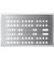







NSX Multi-Site L2VPN: Enterprise
L3 Network
SSL
SSL
Site A
Site B
vCenter
Server
L2VPN Client
L2VPN Server
vCenter
Server
Site B
Uplink Network
Site A
Uplink Network
Site B NSX Edge GW
Site A NSX Edge GW
VLAN 100 172.16.10.0/24
Tunnel ID 10
VM1
VM2
VM3
VM4
VLAN Trunk Interface
VLAN 1000 172.16.10.0/24
Tunnel ID 10
VLAN Trunk Interface
VLAN 200 172.16.20.0/24
Tunnel ID 20
VM1
VM2
VM3
VM4
VLAN 2000 172.16.20.0/24
Tunnel ID 20
Datastore 1
Datastore 2
Notes:
Add connectivity over an L3 network between sites (could be WAN or a network controlled by enterprise)
Site A has it’s own management components (vCenter, NSX Manager and Controllers), and in this example we are extending VLAN 100 and marking it with a tunnel ID of 10, then we also add VLAN 200 tunnel ID 20 and both VLANs are trunked to the NSX Edge GW.
Site B has similar steps where we trunk VLANs 1000 and 2000
Then we eanble L2VPN server at Site B, client on Site A and create an SSL tunnel which bridges networks together that share the same tunnel ID so that they are in the same L2 segment
Network A and Network B can be any type (VXLAN, VLAN), here we are extending VLAN 100 in Site A to 1000 in Site B, and 200 to 2000.
To overcome the above issue, we will change the behavior of step (d) above. Instead of sending ARP request with IP of Edge 1 (11.1) in ARP header, we will send ARP request with IP as 0.0.0.0.
Thus when the ARP request reaches D (as in step (e) above), D does not update it's ARP cache but still responds back with it's ARP reply.
This technique of sending ARP request with 0.0.0.0 as source IP in ARP header is used to detect duplicate address.

Slide 25

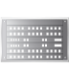



NSX Multi-Site L2VPN: Hybrid Cloud
L3 Network
SSL
SSL
Site A
Site B
L2VPN Client
L2VPN Server
vCenter
Server
Site A
Uplink Network
Site B
Uplink Network
ExistingRouter
Site A Standalone Edge
Site B NSX Edge GW
VM3
VM4
VLAN 50 172.16.10.0/24
Tunnel ID 5
VM1
VM2
VXLAN 5000 172.16.10.0/24
Tunnel ID 5
VXLAN Trunk Interface
VLAN Trunk Interface
VM3
VM4
VXLAN 5001 172.16.20.0/24
Tunnel ID 6
VLAN 51 172.16.20.0/24
Tunnel ID 6
VM1
VM2
Notes:
This slide, shows the standalone edge being used in combination with an existing router at site A – so it’s more of a hybrid cloud use case.
Site A does not require management components such as NSX Manager and NSX Controllers. In our example we are extending VLAN 50 with a tunnel ID of 5, then we also add VLAN 51 tunnel ID 6 and again both VLANs are trunked to the standalone NSX Edge GW.
Site B has a managed NSX Edge with a VXLAN trunk for the two networks being extended.
Then we create an SSL tunnel using the L2VPN
Here we are extending VLAN 50 in Site A to VXLAN 5000 in Site B, and 51 to 5001.
Our third solution leverages the L2VPN solution in the NSX Edge Services GW.
This is a deployment model that can fit both enterprise use cases across 2 vCenter Servers, and Service Provider use cases to provide L2 extension between a customers on premise resources and off premise cloud capacity from the SP.
We start with Compute, network and storage resources at both local and remote sites.
Then Add connectivity over an L3 network between sites
Site A has it’s own management components (vCenter, NSX Manager and Controllers), and we either deploy a logical network, or use an existing network then add an NSX Edge GW.
Site B has similar steps either done by the enterprise, provider or self-service
Then we create an SSL tunnel using the L2VPN feature of NSX for vSphere which bridges the two networks together so that they are on the same broadcast domain
Network A and Network B can be any type (VXLAN, VLAN)
L3 Network typically internet (although could be enterprise L3 network)
Also applies to enterprise, who doesn’t need NSX at Site A
Our configuration, has one edge GW configured as an L2VPN client – here we select the internal network (VLAN backed dvPortgroup in the example) we are extending and define the L2 VPN server IP, Port and credentials
The Site B Edge is configured as an L2VPN server, we again select the internal network (VXLAN logical switch in our example), choose the listener IP and Port (which matches what was configured on the client), encryption algorithm and certificate
The Edges at each site are configured with the same internal IP address to enable local egress, and ensure VMs do not need to change network settings after being migrated.
As L2 is performed before routing, we also require some firewall rules to ensure that VMs don’t send traffic to the remote site as their default gateway. This is accomplished by creating Edge Firewall rules that only allow the local subnet to access the gateway address.

Slide 26
Firewall Enhancements

Slide 27
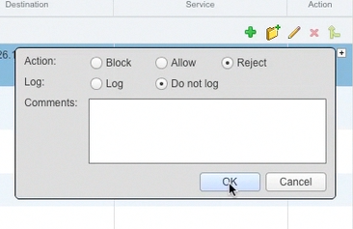
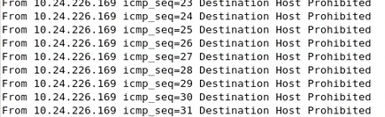
Reject Action
New option in rule action field
Reject action will send back to initiator:
RST packets for TCP connections
ICMP unreachable with administratively prohibited code for UDB, ICMP, and other IP connections.
Notes:
New in 6.1

Slide 28
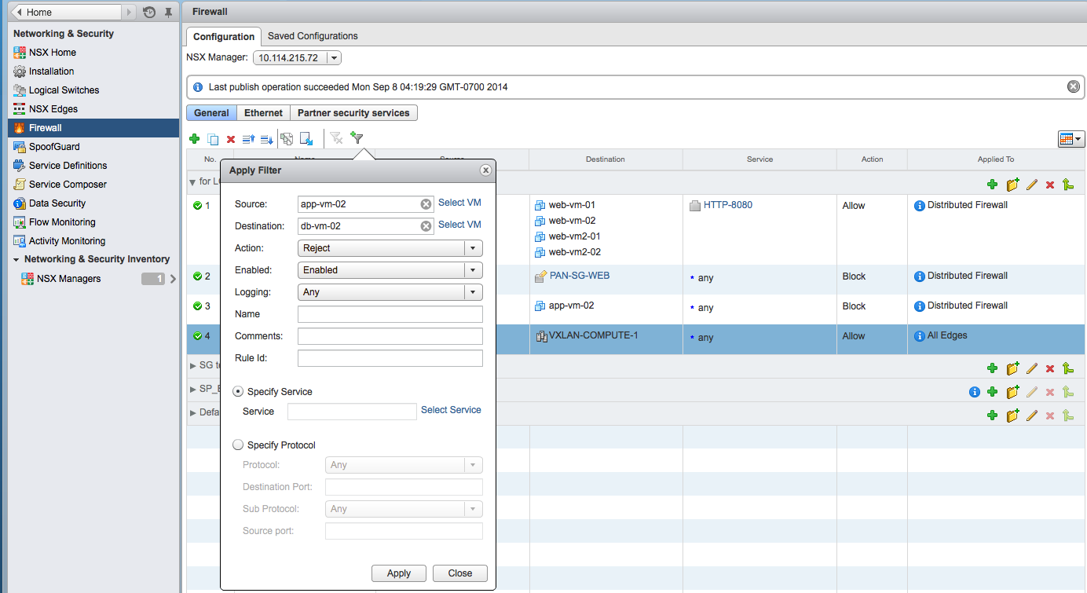
Advanced Rule Filtering
Remove Filter
Apply Filter
Advanced Rule Filtering: filter policy rule display.
Criteria for filtering:
Source / Destination: IPv4/IPv6 Addresses, Any, VM name
Action: Any / Allow / Block / Reject
Enabled: Any / Enabled / Disabled
Logging: Any / Enabled / Disabled
…
Notes:
New in 6.1

Slide 29
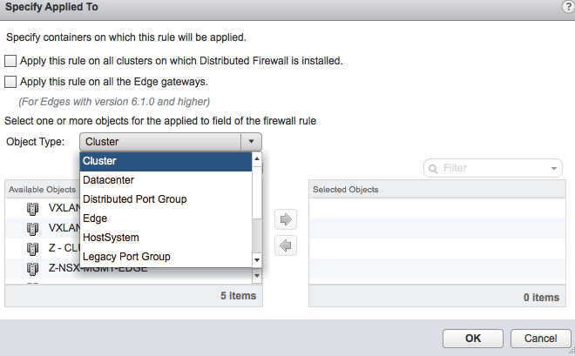
Combined Firewall UI
Central management of rules applied on the distributed firewall or any NSX Edge Services Gateway (ESG)
Applied to DFW or ESG
Notes:
New to 6.1

Slide 30
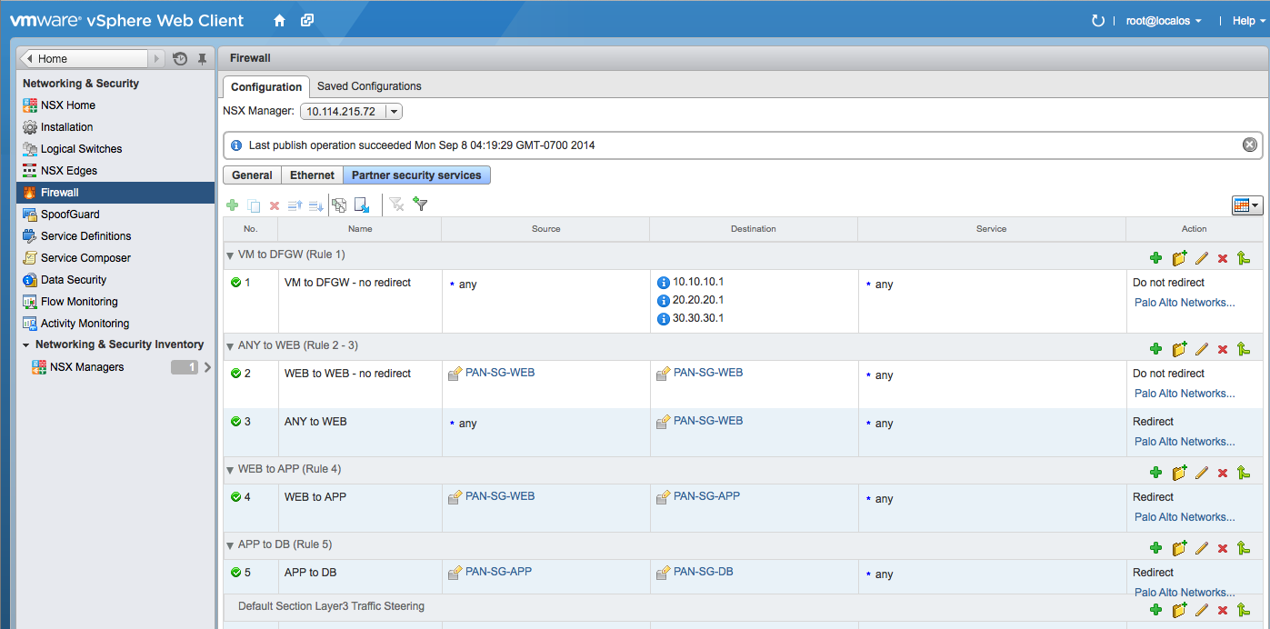
Partner Security Services (1)
New tab under Firewall menu to configure traffic redirection policy rule
Source/Destination:
Cluster
DC
DVS port group
IP Sets
Logical Switch
Resource Pool
Security Group
vAPP
VM
vNIC
Notes:
New to 6.1

Slide 31
Partner Security Services (2)
Service:
Same list as service for DFW policy rules
Notes:
New to 6.1

Slide 32
Partner Security Services (3)
Action:
Redirect
Do not redirect
Redirect to:
Any 3rd party vendor
Registered with NSX
Notes:
New to 6.1

Slide 33
Operations Enhancements
Logging:
Rule messages are now stored in a dedicated file
Threshold Event:
Configurable threshold values for:
CPU
Memory
CPS (connections per second)
Syslog and NSX event messages triggered when value exceeds threshold
IP Flow Information Export (IPFIX):
Enabled in Flow configuration > Configuration > IPFIX
DFW exports IPFIX information about processed flows
Supported collectors:
Plixer Scrutinizer Collector
Netflow Integrator
Notes:
Logging:
Rule messages are now stored in a dedicated file
New to 6.1
Threshold Event:
New to 6.1
Configurable threshold values for:
CPU
Memory
CPS (connections per second)
Syslog and NSX event messages triggered when value exceeds threshold
IP Flow Information Export (IPFIX):
New to 6.1

Slide 34
Load Balancing and ADCaaS

Slide 35
Load Balancing Enhancements
Protocol additions:
UDP, FTP
LB method additions:
HTTP header/URL
Health Check additions:
UDP
Miscellaneous enhancements:
L4 stateful failover
VC container support to add members to pool
Configurable persistence expire time
Partner integration enhancements:
LB/ADC partner integrations
NSX centrally configures all network and security services (LB included)

Slide 36

NSX / F5 Joint Solution Overview
Features
Any Application
(without modification)
NSX integrates with F5 BIG-IQ
F5 Admin defined iApps published to NSX Manager
BIG-IPs VEs get automatically deployed, licensed and configured
User can consume F5 iApps from NSX UI or API
Virtual Networks
Any Cloud Management Platform
VMware NSX Network Virtualization Platform
Logical Firewall
Logical
Load Balancer
Logical
VPN
Logical
Load Balancer
Logical L2
Logical L3
Any Hypervisor
Any Network Hardware
Benefits
Virtual IP: 172.168.1.1
Member pool: 10.0.0.1, 10.0.0.2
ADC template (iApp):
Web Gold
Compatible with all NSX features
Seamless support for virtual networks and traditional networking with VLANs
Familiar workflows for all teams (in NSX , and in F5 BIG-IQ)
Supports virtual form factor of F5 appliances
Limitations on some F5 features (no multi-tier iApp, no F5 security modules)
Future support for any CMP including vCAC
Future support for physical appliances in the further release

Slide 37
Platform Enhancements

Slide 38
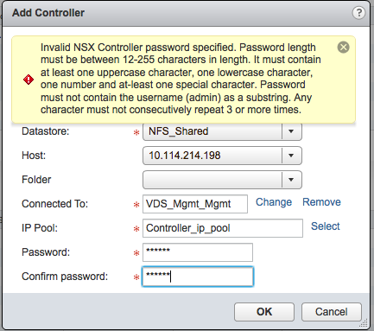
Controller Security
Password strength requirement similar to NSX Edge 6.0
12-255 characters in length
Must contain at least one of each:
Lowercase character
Uppercase character
Number
Special character
Cannot contain
The word admin
Any character repeated three or more times
Notes:
Enhanced in 6.1

Slide 39
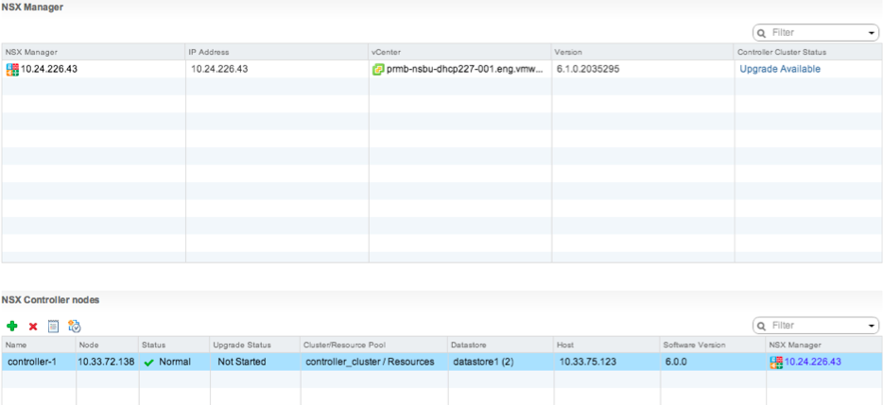
One-Click Controller Upgrades
If an upgrade is available:
An upgrade link is available in the UI
A one-click upgrade is provided for the administrator
Notes:
New in 6.1

Slide 40
Host-Level Packet Capture
CLI-based troubleshooting tool
Can operate at any stage in the packet lifecycle:
dvPort
Vmknic
Uplink
Extensive range of filters:
Source/destination MAC
IP protocol
VLAN ID
VXLAN ID
Ports
Many others…
Pcap format output
Export for use with common protocol analyzers
Notes:
Host-level packet capture on an ESXi host is not new – that NSX can now leverage it is a new feature to 6.1.

Slide 41


Traceflow
Provides a coordinated way of capturing packet exchanges between VTEPs
The NSX Controller leverages host-level packet capture across two participating hosts
1
2
3
4
5
6
Host A
Host B
VTEP1
VTEP2
ping
Notes:
New to 6.1

Slide 42
vCloud Automation Center 6.1 Integration

Slide 43
vCloud Automation Center 6.1 Integration (1)
Connectivity:
Network Profiles for On-Demand Network Creation
Routed, NAT, private, external profiles based on Application Topology
NSX Distributed Logical Router (DLR) Support
Connect to pre-created External networks
Optimize east-west traffic by connecting On-Demand Logical Switches to a pre-created DLR
All On-Demand Edges use NSX 6.1 version
Availability:
On-demand Load Balancer in One-Armed Mode or Inline Mode
NSX Load Balancing configuration used
Extensibility:
Business Logic moved to NSX vCO Plugin
Notes:
Connectivity:
Network Profiles for On-Demand Network Creation
Enhanced and expanded in 6.1
NSX Distributed Logical Router (DLR) Support
Enhanced and expanded in 6.1
Availability:
On-demand Load Balancer in One-Armed Mode or Inline Mode
Enhanced and expanded in 6.1
Extensibility:
Business Logic moved to NSX vCO Plugin
Enhanced in 6.1

Slide 44
vCloud Automation Center 6.1 Integration (2)
Security:
App Isolation
Automatic creation of security group per app with default policy to permit traffic between tiers and block all inbound/outbound traffic
On Demand creation of Security Groups based on Security Policies
Select pre-defined NSX security policies which apply to security groups for component VMs
Allows self-service consumption of DFW Rules, AV, DLP, IDS/IPS, Vulnerability Management
Security Tags
Select pre-defined NSX security tag which is applied to VMs and used to dynamically place workloads in security groups
Notes:
Security:
App Isolation
Enhanced in 6.1
On Demand creation of Security Groups based on Security Policies
Enhanced in 6.1
Security Tags
Enhanced in 6.1

Slide 45
vCloud Automation Center 6.1 Integration (3)
Product Compatibility Matrix:
vCO server embedded with vCAC VA includes the NSX vCO plugin by default
A standalone vCO server is recommended for production
Requires installation of the NSX plugin
Product | Version
vCAC | 6.1
vCO Server | 5.5.2
NSX vCO Plugin | 1.0
NSX vSphere | 6.1.0

Slide 46
Resources

Slide 47
Documentation and Software
Product Documentation: (Live after GA) https://www.vmware.com/support/pubs/nsx_pubs.html
NSX for vSphere Installation and Upgrade Guide
NSX for vSphere Administration Guide
NSX for vSphere API Reference Guide
NSX for vSphere Command Line Interface Reference
Software available for download by customers (Live after GA)
NSX-v upgrade bundle
NSX-v OVA
vShield upgrade bundle
Standalone Edge for L2VPN
VCO Plug-in and README

Slide 48
Key Points
Questions?

